Slide 1
duolingo
Instagram Profile Analysis Presentation
2026-02-11
Notes:
title_page

Slide 2
How to use this deck
This deck is your secret marketing intelligence tool and superpower. It’s your shortcut to finding the macro and micro nuggets of information and inspiration you need to craft killer strategy.
By scouring this Instagram profile, we’ve tracked the conversations and content that matter. All of it has then been distilled to this presentation, so you know what matters to this audience.
So use it to get inspired. Use it to learn. Use it to know more about this brand than your competition. But however you use it, use it wisely.
Enjoy!
❤️ Autostrat Team
Notes:
how_to_use

Slide 3
Audience Profile
Duolingo’s audience is a motivated, global tribe passionate about recognition and community. They seek fun, accessible learning but face frustration from app limits and insufficient support, craving inclusivity and authentic engagement.
NEEDS
Desire for meaningful rewards recognizing long-term learning commitment | Clear, responsive customer support to resolve streaming or app issues quickly | Accessible, inclusive language options reflecting global user diversity
OBJECTIONS
Frustration with monetization and feature changes perceived as restrictive | Skepticism about inclusivity efforts, especially LGBTQ+ content in education | Distrust arising from perceived poor app reliability and opaque subscription practices
DESIRES
Achieve mastery and social recognition through consistent learning streaks | Belong to a vibrant, supportive global community sharing the language journey | Access education easily and on their own terms, avoiding friction and limits
PAIN POINTS
App feature changes disrupt user experience and learning momentum | Insufficient customer support and slow response to user issues | Limited language offerings leave many users underserved and disengaged
Notes:
audience_analysis

Slide 4
To win here, prioritize celebrating commitment visibly, leverage humor through a mascot persona, and embed partnerships in current culture with playful, timely content that feels genuine and community-rooted.
How to Win With This Audience
Territory 1
Center campaigns around public learning achievements fueling social identity pride.
Territory 2
Use mascot-driven humor to humanize brand voice and invite playful engagement.
Audience Verbatims
Territory 3
Embed content in real-time cultural trends and viral meme formats relentlessly.
Duo, next week I’ll complete a 5-year streak :) You should send me something as a gift (you’re my longest relationship)
I hear you’re giving out merch now for long streaks? Is 1119 days long enough for you? 😇
this made me remember to do my lesson
Hi Duolingo Team! I’m so happy my streak is back! 🌟 Thank you for all your support—daily learning with you has been super motivating! 💚
I absolutely love Duolingo marketing
Territory 4
Reward loyal behavior tangibly to deepen emotional connection and advocacy.
Territory 5
Maintain daily, diverse formats to balance fresh relevance with audience stamina.
Notes:
how_to_win

Slide 5
Future Sponsorship Suggestions
Duolingo’s Instagram strategy leverages mascot humor and social streak culture to engage Gen Z deeply. Partners in lifestyle, tech education, entertainment, and merch can co-create culturally relevant, interactive content to tap this energized audience effectively.
Lifestyle and Beverage Brands
Tech and Learning Tools
Entertainment and Media
Apparel and Merchandising
Lifestyle brands match Duolingo’s upbeat, social engagement style perfectly. | Tech and learning brands fit Duolingo’s smart, playful educational ethos. | Entertainment brands amplify impact via Duolingo’s viral pop culture play. | Merch delivers physical validation stoking user pride and retention.
Why it Works | Why it Works | Why it Works | Why it Works
Duolingo’s playful, culturally aware persona aligns well with lifestyle and beverage brands targeting Gen Z, leveraging humor and mascot engagement to amplify brand presence in social contexts. | Duolingo’s educational foundation combined with viral content models is ideal for tech-learning platforms seeking to humanize and gamify education with fresh, engaging voices. | Duolingo’s timely pop culture tie-ins and viral dance-meme content perfectly suit entertainment brands aiming for cross-platform buzz and cultural relevance with younger audiences. | Users’ desire for physical rewards linked to their learning streaks suggests apparel and merch brands can unlock potent emotional loyalty by materializing community achievements.
How to Activate | How to Activate | How to Activate | How to Activate
Create co-branded short videos featuring mascot cameo in everyday social scenarios. Leverage streak milestones as campaign hooks tied to exclusive lifestyle product rewards. Develop viral challenges integrating brand with language and social themes. | Co-develop interactive content aligning app features with mascot-driven humor. Host live-streamed educational challenges centered on streaks and rewards. Launch user-generated content contests boosting product trial and advocacy. | Co-create themed content tying media releases to mascot antics and memes. Leverage trending hashtags and dances with co-branded influencer takeovers. Produce episodic content combining language learning with entertainment formats. | Launch limited-edition lifestyle merch rewarding streak milestones and community events. Integrate unboxing and reveal content featuring the mascot to turbocharge excitement. Host exclusive merchandise drops tied to viral social challenges.
Notes:
future_sponsorships

Slide 6
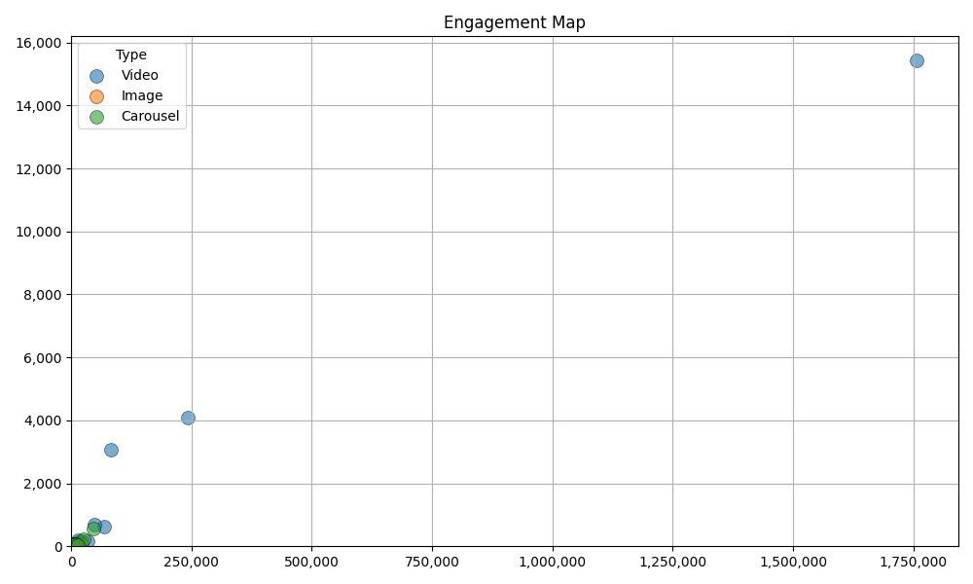
Engagement Analysis
Summary
Audience engagement is deeply driven by humor and relatability, with meme-based videos and mascot-led skits pulling significant likes and comments.
Episodes linking real struggles—like streak continuity—and pop culture references ignite conversation and shares.
Vibrant replies from Duolingo amplify this, creating a dialogue loop that strengthens community loyalty.
Conversely, posts around less-loved product changes see vocal negativity, evidencing authentic emotional investment that can swing either way.
Notes:
engagement_analysis

Slide 7

Snapshot
We’ve scoured this profile to understand how this account speaks to their audience while uncovering the real conversations, emotions, wants and needs happening in the comments.
duolingo
Followers
Following
4,779,731
291
Avg Likes
Avg Comments
Avg Engagement Rate
98,092
1,042
2.07 %
All performance and averages are based on last 50 uploads
Engagement rate calculated as comments and likes over followers
Notes:
creator_snapshot

Slide 8
Creator Summary
Search Purpose
Benchmark Duolingo as an aspirational social brand for Cuervo. What is their content strategy, posting cadence, tone of voice, and engagement approach? How do they stay culturally relevant with Gen-Z?
Topline
Common Themes and Topics
Language learning streaks and challenges form the heart of their content, spotlighting user achievement and community milestones, driving motivation and participation.
Duolingo energizes language learning with humor, trend-savvy videos, and a sassy mascot.
Their content fuses memes, pop culture, and user streaks to engage Gen Z daily on Instagram.
What Hits
Bitesize, funny videos leveraging memes, mascot antics, and streak highlights attract peak engagement and viewer participation.
What it Means for You
Duolingo’s blend of humor, mascot-persona, and user engagement creates a potent, Gen Z-attracting mix brands can emulate.
It’s a strategic model for culturally resonant brand partnerships.
What Misses
App feature updates generate friction; dry, non-humorous posts underperform.
Notes:
creator_summary

Slide 9
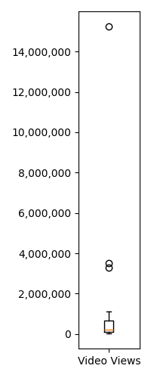
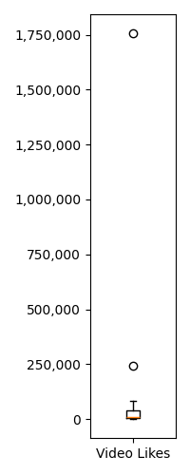
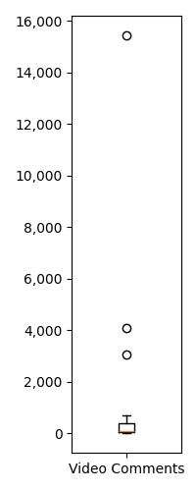
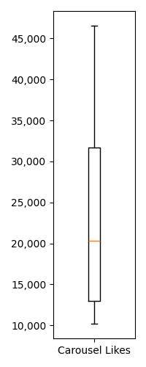
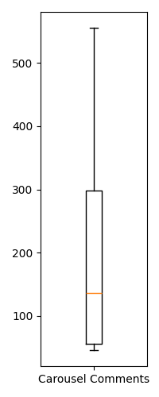
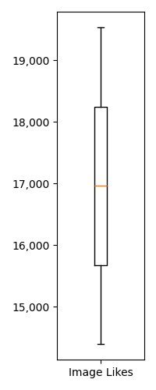
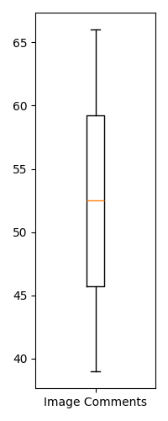
Summary Statistics - By Post Type
Videos
Carousels
Images
Video Post Count: 19
Carousel Post Count: 4
Images Post Count: 2
Min Views | 28,279
Max Views | 15,230,995
Median Views | 221,185
Avg Views | 1,405,561
Min Likes | 531
Max Likes | 1,755,786
Median Likes | 9,178
Avg Likes | 122,159
Min Comments | 12
Max Comments | 15,426
Median Comments | 78
Avg Comments | 1,319
Min Likes | 10,199
Max Likes | 46,542
Median Likes | 20,314
Avg Likes | 24,342
Min Comments | 46
Max Comments | 555
Median Comments | 136
Avg Comments | 218
Min Likes | 14,398
Max Likes | 19,528
Median Likes | 16,963
Avg Likes | 16,963
Min Comments | 39
Max Comments | 66
Median Comments | 52
Avg Comments | 52
Notes:
post_summary_statistics

Slide 10
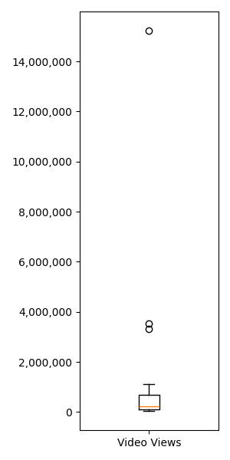
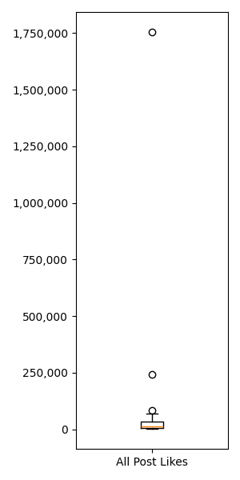
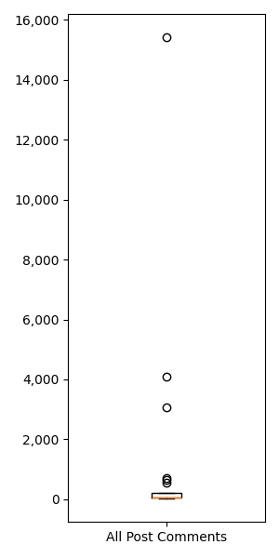
Summary Statistics - All Posts
Views
Likes
Comments
Min Views | 28,279
Max Views | 15,230,995
Median Views | 221,185
Avg Views | 1,405,561
Min Likes | 531
Max Likes | 1,755,786
Median Likes | 14,398
Avg Likes | 98,092
Min Comments | 12
Max Comments | 15,426
Median Comments | 72
Avg Comments | 1,042
Notes:
all_summary_statistics

Slide 11
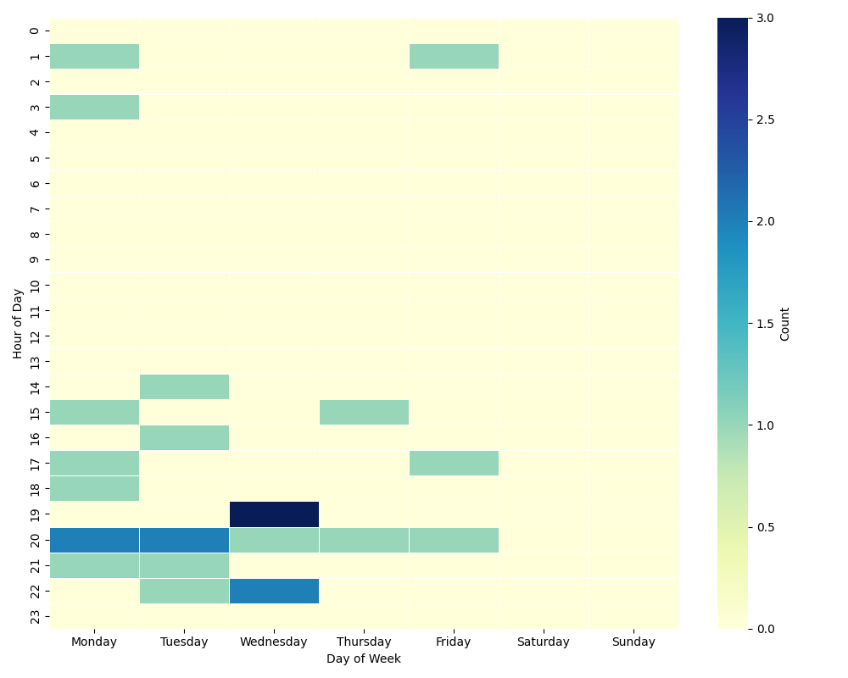
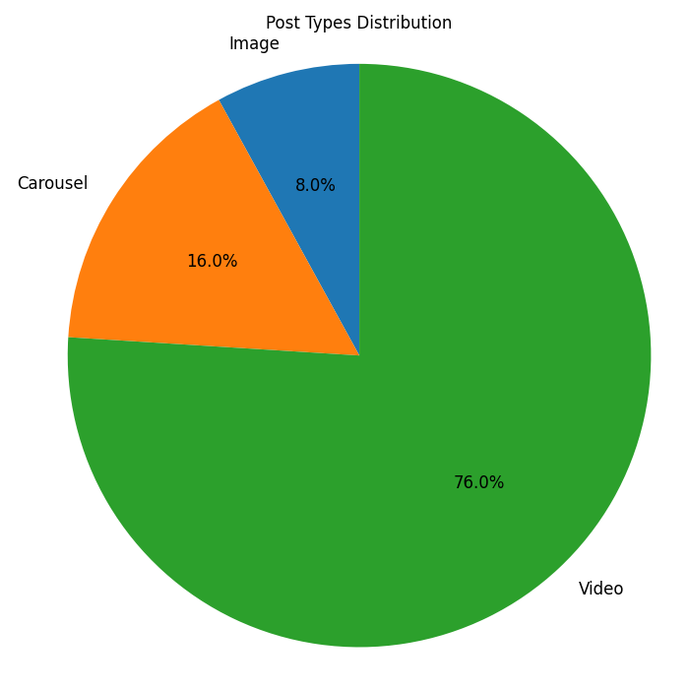
Posting Analysis
Summary
Posting Heatmap
Post Mix
Duolingo’s cadence is relentless daily activity, balancing bite-sized videos with carousels and images.
Content timing aligns with cultural moments and trends, supporting maximum relevance.
Formats pivot smartly: fast-paced, under-1-minute videos deliver humor and memes, while longer-form content like anime promos engage deeper fandoms.
They actively test animation styles, influencer collabs, and user shoutouts, signaling a layered, adaptive content mix designed to maintain high visibility and shareability without oversaturating.
Notes:
posting_analysis

Slide 12
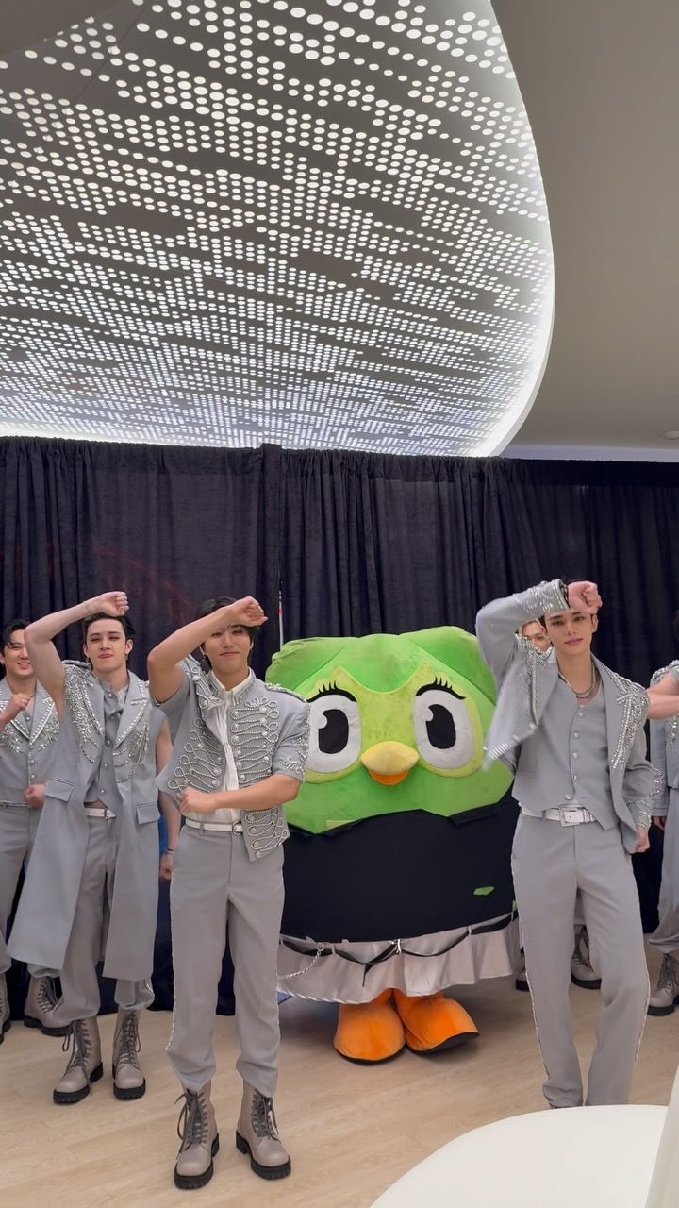
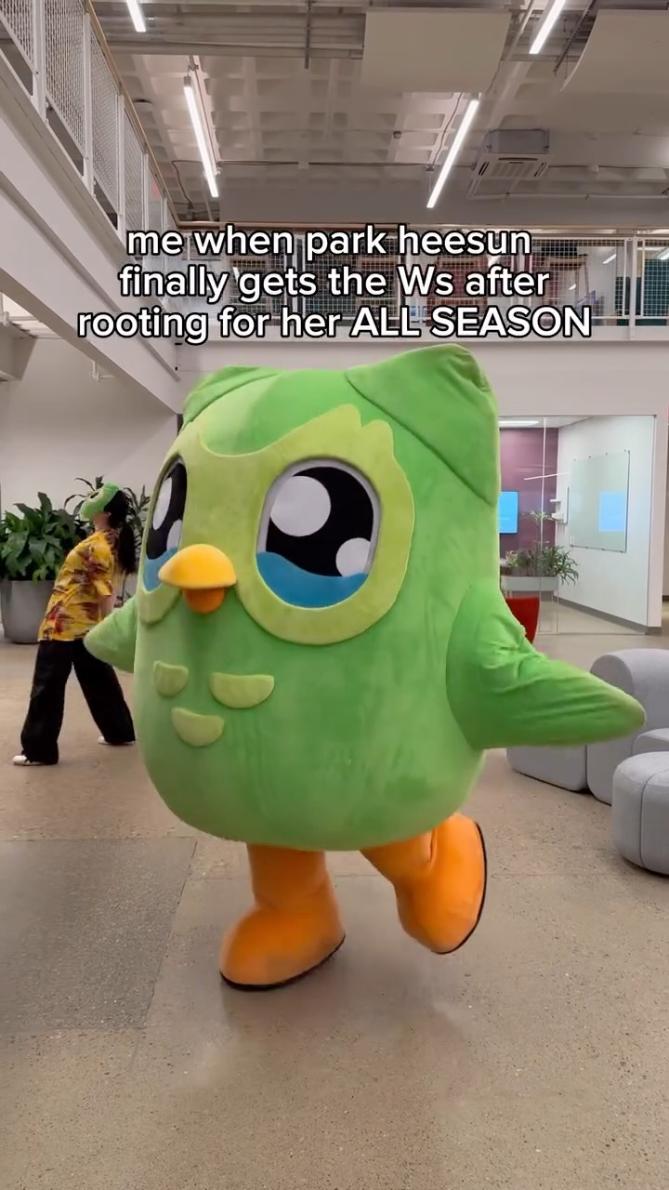
Most / Least Liked
Most Liked
Least Liked
Caption | #ChkChkBoom Challenge 🎯 w/ @Duolingo #duolingo #듀오링고 #StrayKids #스트레이키즈 #ATE #ChkChkBoom #dominATE_NEWYORK #YouMakeStrayKidsStay
Engagement Rate | 37.06 %
Likes Count | 1,755,786
Comment Count | 15,426
Link | https://instagram.com/p/DLIVMyORu3K/
Caption | like noona, i’m in pittsburgh😏 @heesunrose #duolingo #singlesinferno
Engagement Rate | 0.01 %
Likes Count | 531
Comment Count | 12
Link | https://instagram.com/p/DUojQ4EEe0t/
All performance and averages are based on last 50 uploads
Engagement rate calculated as comments and likes over followers
Note statistics may be skewed due to recency bias
Notes:
most_liked

Slide 13
Most / Least Comments
Most Comments
Least Comments
Caption | #ChkChkBoom Challenge 🎯 w/ @Duolingo #duolingo #듀오링고 #StrayKids #스트레이키즈 #ATE #ChkChkBoom #dominATE_NEWYORK #YouMakeStrayKidsStay
Engagement Rate | 37.06 %
Likes Count | 1,755,786
Comment Count | 15,426
Link | https://instagram.com/p/DLIVMyORu3K/
Caption | like noona, i’m in pittsburgh😏 @heesunrose #duolingo #singlesinferno
Engagement Rate | 0.01 %
Likes Count | 531
Comment Count | 12
Link | https://instagram.com/p/DUojQ4EEe0t/
All performance and averages are based on last 50 uploads
Engagement rate calculated as comments and likes over followers
Note statistics may be skewed due to recency bias
Notes:
most_comment

Slide 14
Most / Least Engaged
Most Engaged
Least Engaged
Caption | #ChkChkBoom Challenge 🎯 w/ @Duolingo #duolingo #듀오링고 #StrayKids #스트레이키즈 #ATE #ChkChkBoom #dominATE_NEWYORK #YouMakeStrayKidsStay
Engagement Rate | 37.06 %
Likes Count | 1,755,786
Comment Count | 15,426
Link | https://instagram.com/p/DLIVMyORu3K/
Caption | like noona, i’m in pittsburgh😏 @heesunrose #duolingo #singlesinferno
Engagement Rate | least_engaged_rate_placeholder
Likes Count | 531
Comment Count | 12
Link | https://instagram.com/p/DUojQ4EEe0t/
All performance and averages are based on last 50 uploads
Engagement rate calculated as comments and likes over followers
Note statistics may be skewed due to recency bias
Notes:
most_engagement

Slide 15
Appendix

Slide 16
Audience Dive

Slide 17
Users demand meaningful rewards for commitment, inclusive language options, responsive support, and playful, trendy content to sustain motivation and belonging.
Audience Needs
Evidence
Verbatims
Users frequently mention streak milestones and expect recognition or gifts.
Users frequently complain about bugs, lost streaks, and unresponsive support.
Many users request addition of less-common languages and dialects.
Top-performing posts are humorous, meme-rich, and pop-culture integrated.
Duo, next week I’ll complete a 5-year streak :) You should send me something as a gift (you’re my longest relationship)
I hear you’re giving out merch now for long streaks? Is 1119 days long enough for you? 😇
I have a 687 days streak… and you never even congratulated me, I see how it is, it just doesn’t mean anything to you does it…
duo my streak is 1359 please send me a package
I’m a 724 day streak, and yes, I brag about it to everyone.
Expressions
Users explicitly request gifts and celebrate streak milestones, showing deep investment in recognition.
Recurring user complaints about technical problems and neglected support exemplify this urgent need.
Requests for new languages appear frequently, showing demand for inclusivity and cultural representation.
Repeated user praise and lively engagement reflect appetite for playful, culturally tuned content.
Notes:
audience_need

Slide 18
Users vocalize hesitance due to restrictive monetization features, concerns over ideological inclusivity content, frustrations with support and subscription management, and occasional fatigue from intense content volume, signaling key barriers brands must address to sustain trust and engagement.
Audience Objections
Evidence
Verbatims
Negative sentiment explodes around new features limiting free use.
Some parents express concerns about ideological content in educational materials.
Users report confusion over subscriptions and bugs creating distrust.
Some users express overwhelmed feelings with daily, rapid content.
Every update y’all drop feels like punishment
How am I supposed to learn when I spend more time waiting for batteries
Hate the new update can only play a little bit now. 🙄 had this app for a decade but if this is the direction it's taken might be time to find a new app to play.
Hey so stop ignoring our comments about how batteries suck from over 4 weeks ago we know you see us
Your customer service is atrocious.
Expressions
Persistent user complaints and threats to quit demonstrate deep frustration.
Comments reveal a vocal subset uneasy with content direction and brand choices.
Consistent user feedback points to subscription management opacity and app bug fatigue.
Feedback reflects tension between engagement drive and user cognitive load.
Notes:
audience_objection

Slide 19
Users want to master languages with social recognition, belong to an engaged global community, avoid painful friction, and enjoy culturally vibrant, entertaining content.
Audience Desires
Evidence
Verbatims
Streaks are a social currency and identity marker for users.
Users rally around shared milestones, challenges, and cultural events.
Users resist changes that add barriers or restrict usage.
Top engagement occurs on meme-driven, culturally relevant, and mascot-led content.
Duo, next week I’ll complete a 5-year streak :) You should send me something as a gift (you’re my longest relationship)
I hear you’re giving out merch now for long streaks? Is 1119 days long enough for you? 😇
The wink did something to us 😏
How am I supposed to learn when I spend more time waiting for batteries
I lost my 285 days streak on Duolingo pls I'll do anything to have it back pls
Expressions
Widespread social signaling of streaks and hope for material validation.
User comments brimming with mutual support, memes, and shared challenges.
Strong resistance to app-imposed limits and frustration over UX changes.
User enthusiasm and meme participation indicate craving for playful, culturally tuned content.
Notes:
audience_desire

Slide 20
This audience faces friction from disruptive app changes, inadequate customer support, limited language inclusivity, and fears over content ideology overshadowing education — presenting critical risk points that brands must strategically mitigate with clarity, responsiveness, and inclusivity.
Audience Painpoints
Evidence
Verbatims
The introduction of 'battery' limits has sparked widespread frustration and churn threats.
Users report long waits and ignored queries, compounding frustration from app issues.
Frequent requests for additional languages and dialects illustrate limitations.
Concerns arise that Duolingo mixes ideology with education especially around inclusivity.
How am I supposed to learn when I spend more time waiting for batteries
Every update y’all drop feels like punishment
You keep saying you care about learners, prove it by fixing what’s broken.We’re not asking for much. Just give us our learning experience back.
Hey so stop ignoring our comments about how batteries suck from over 4 weeks ago we know you see us
You took my 50 day streak away for no reason because of a bug in the app and support never answered.
Expressions
User comments rage against newer app mechanics perceived as barriers, illustrating a real friction point.
Users vocalize ongoing disappointment with customer service responsiveness amid technical struggles.
User demand signals missed opportunity and dissatisfaction around language availability.
Voiced worries about content and pedagogy reflect trust and adoption barriers.
Notes:
audience_painpoint

Slide 21
Thanks!

